Slide 1

Computer System Architecture
Assignment 01
Higher Nationals Diploma in Computing & Subsystems Development
Shenesh Perera

Slide 2
IT Executive Training
Training Package
The package will go cover the following;
Introduction to subsystems and interaction between systems to achieve tasks.
Complete comprehensive explanation on the Central Processing Unit.
Central Processing Unit Infrastructure.
Main Memory & it’s types.
Input & Output subsystem
Various hardware & software used in the job industry.
Personal advice & criticism are spread widely in the package.
Notes:
Central Processing Unit, Main Memory and Input/Output(Peripherals involved such as hard disks, RAMs, ROMs, storage devices & printers) Subsystems
How the CPU performs the fetch, decode & execute cycle. What a CPU is, it’s purpose, importance and types of CPUs.
Subdivisions of the CPU and comprehensive analysis. Implicit electrical interaction involved.
Microsoft office & Adobe Collection. Canon Printers, biometric scanners, monitors
Intel & AMD CPUs and demand in job market.
Practices like refraining from consuming food, maintaining proper ventilation etc.
Please have your with you handout now.
What an operating system is, purpose and interaction with the rest of the system.
Layered, Micro, DOS & Monolithic then further explanation on what GNU/Linux kernel is.
Advice based on my experience, knowledge and expertise with relation to what has been discussed.

Slide 3
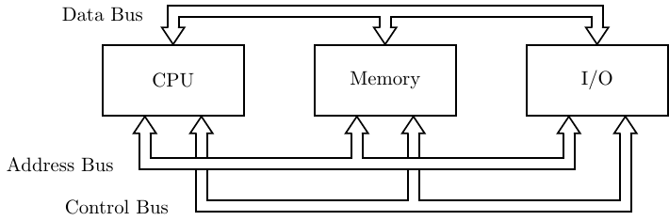
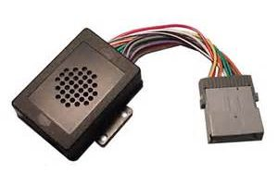
What is a system & a subsystem ?
A system is a complete collection of independent units that interact with each other.
A subsystem is one such unit in a one complete system.
A subsystem by itself is a system.
A subsystem must be capable of interacting with other subsystems to initiate and process tasks.
In a computer system there are 3 subsystems; CPU, Main memory & Input/ Output.
Figure 1.1/1.2 itlovers.com, 2014/04/03
Notes:
A system must be capable of performing implicit tasks while being independent of any other external factor and must be a compilation of independent subsystems that perform functions for the system when requested.
A subsystem is a system by itself that works under another system and provides services to it and requests information form it.
A computer system performs tasks by the conjoined action of 3 subsystems; The Central Processing Unit, Main Memory & Input/Output.
The CPU is responsible for processing raw data to comprehensible information.
The Main Memory is responsible for storing data or information while processing is going on(The RAM & ROM)
The Input/Output subsystem is responsible for providing an interface for liveware(humans) to give instructions to the system to perform (input) and then receive intended information in a comprehensible manner(output). There are plenty of devices that perform Input & Output.
The 3 subsystems are connected to each other by 3 buses(sets of wires, example see image on left) which are the; Data, Address and Control buses.
Information & data is carried between the subsystems through the buses, which allows each subsystem to independently communicate with each other.
A computer system can not function if any of the 3 subsystems are not present.

Slide 4
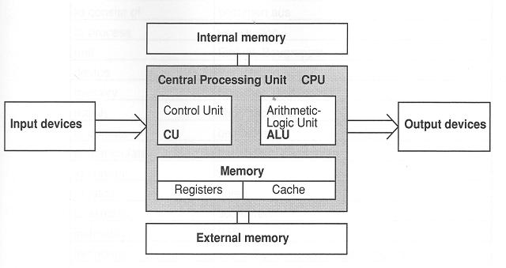
Central Processing Unit
Abbreviated as CPU, is what is commonly known as a processor.
A processor as it’s name suggests is entirely responsible for processing raw data to comprehensible information under the intended demand of a user.
A Central Processing Unit consists of 3 parts; Arithmetic Logic Unit(ALU), Control Unit(CU) and a set of registers.
These 3 parts are completely independent of each other but is capable of communicating with each other.
In the modern day, you find microprocessors in higher
availability than processors, although the function is
same there architecture is different.
A microprocessor is an individual Integrated Circuit made
of a semiconductor like Silicon(Germanium
in the past).
Figure 1.3, ictindepth.com, 2015/05/15, Mr.Aaron
Notes:
Processors perform the decision making in a computer system. The so called “brain” of a computer system. All raw incomprehensible huge stacks of data are completely processed into humanely comprehensible information ex: Obtaining a bunch of even numbers from a set of numbers;
Data [ 4, 2, 3, 9 ] → Information [ 2 , 4 ]
The Arithmetic Logic Unit is primarily concerned in performing mathematical and bitwise logic on binary digits. It does most of the decision making in a computer system through logic.
The Control Unit is the head of all the 3 parts inside a CPU. It controls the workflow, how instructions are perceived and directs the other 2 parts.
A memory unit is composed of registers & a cache. This particular memory unit is very fast so as to allow the CPU to grab stored information as soon as possible during processes.
Microprocessors are much more common in the modern industry vastly due to the fact that they’re much less expensive and have high performance, this is due to the usage of a single Integrated Circuit which is cost-efficient than it’s relative Discrete circuits.
There are millions of electrical components inside a processor, ex: transistors and capacitors that allow the fetch, decode & execute process and storing electrical energy.

Slide 5
Fetch, Decode & Execute Cycle
This cycle essentially is the process cycle of a computer's central processing unit in retrieving instructions from programs during the event of a computer system’s operations.
During the fetch execute cycle, the computer retrieves a program instruction from its memory. It then establishes and carries out the actions that are required for that instruction.
The cycle of fetching, decoding, and executing an instruction is continually repeated by the CPU whilst the computer is turned on.

Slide 6
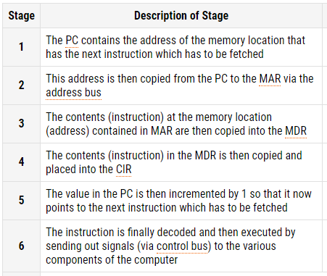
Figure 1.4, computerscience.gcse.guru, 2016/09/18

Slide 7
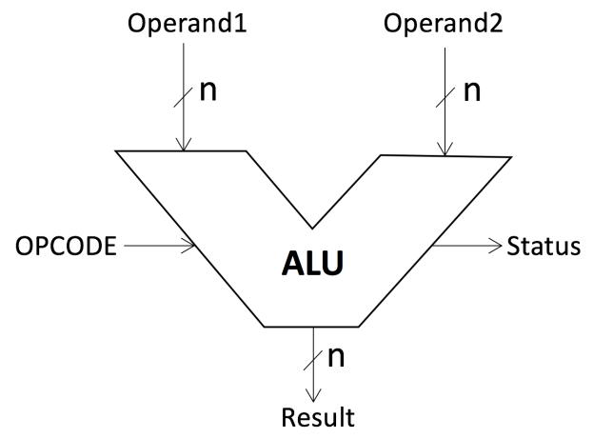
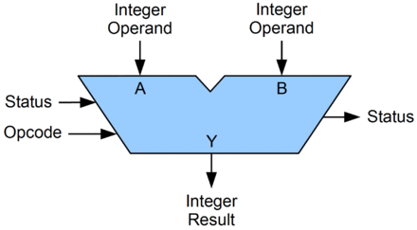
Arithmetic Logic Unit
The ALU performs logic, shift and mathematical operations on incomprehensible data.
Logic operations are those that involve the processing of values with a true/false condition ex: AND, NOR etc.
Shift operations are a mathematical process by which a series of binary digits are either shifted right or left
Mathematical operations are those that include addition, subtraction, division or multiplication on numbers.
Notes:
All operations involved in the ALU find there origins in mathematics. Logic & shift are both mathematical processes.
HARVARD REFERENCING FOR IMAGES HERE: Figure 1.5, 1.6 itdevelopments.com, 2017/06/12

Slide 8
Logic operations are those such that when an input is given under a specific condition a result will be provided. There are multiple types of logic operations AND, NOR, XOR etc.
For example AND is a logic that only provides a result if both conditions provided to it have been achieved. A [1] | [1] high voltage should be passed.
Shift operations are a type of bitwise operation, meaning all digits in a set of binary digits will be affected. Mathematically, all digits are said to be shifted in a nth power of base 2.
Mathematical operations are simple math performed on post fixed formulas or equations.

Slide 9
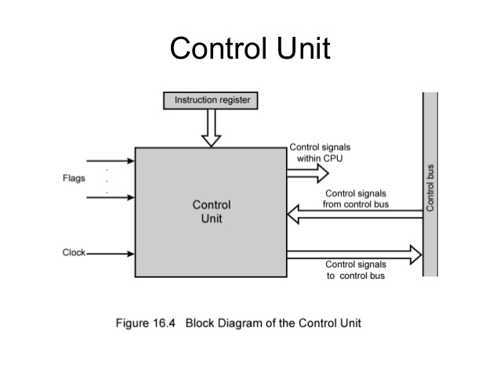
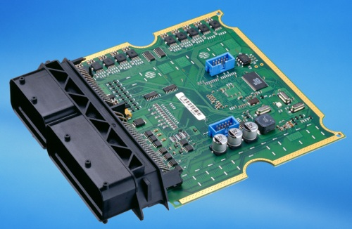
Control Unit
The control unit completely controls the rest of the CPU, directs processes and most importantly manages resources of a system.
It’s a variable sized compilation of very complex digital circuits.
It uses implicit programs to help perform it’s tasks as a control unit.
Figure 1.7- techopedia.com 2017/08/11, Figure 1.8 Geekdashboard.com 2014/03/13
Notes:
The control unit achieves it’s dominancy by interacting using the help of electrical signals with all the subsystems of a computer system.
These electrical signals are often called “control signals”. A control signal can not be ignored by any other subsystem.
After which the processor tells any involved and attached peripheral what operations to carry out.
The functions that a control unit performs are dependent on the type of CPU, as the architecture behind each CU is dependent on the intended function it is to carry out.

Slide 10
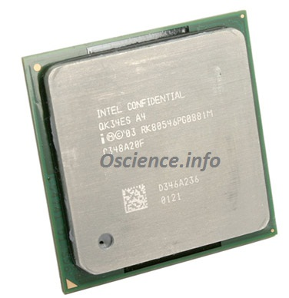
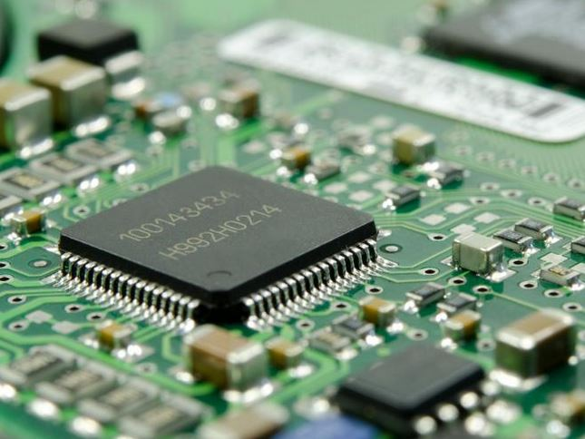
Memory Unit
The memory unit is composed of registers & a cache.
A register is a type of fast and small memory the computer system uses during processing.
A cache is particular amount of memory reserved in such a way that when the same task is repeated it can be done much faster.
Figure 1.9 & 1.1b, oscience.info, 2009/01/16
Notes:
A register is one of a small set of data holding places that are part of the computer processor.

Slide 11
A register may hold an instruction, a storage address, or any kind of data Some instructions specify registers as part of the instruction. For example, an instruction may specify that the contents of two defined registers be added together and then placed in a another register.
A register is small BUT it must also be large enough to hold an instruction for example, in a 32-bit computer, a register must be 32 bits in size.
There are 3 types of registers; Data, Instruction & Program.
Cache memory is a high-speed static random access memory (SRAM) that a computer microprocessor can access more quickly than it can access a type of main memory called random access memory (RAM).

Slide 12
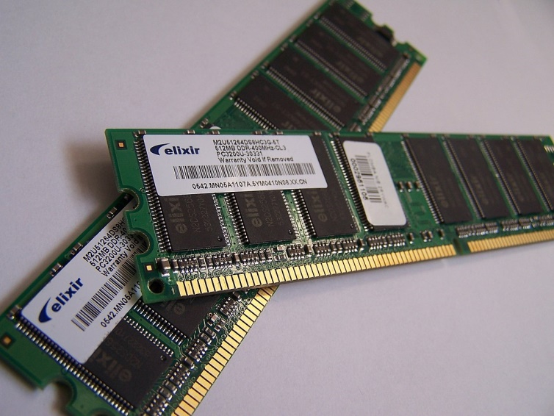
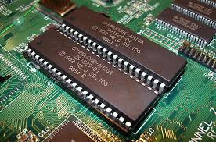
Main Memory
There are 2 types of main memory called Primary Memory; Random Access Memory & Read Only Memory.
RAM stores any machine code or data that’s related to the currently active process.
RAM reads data in a manner that’s irrespective of order.
ROM stores information that is not frequently erased.
RAM is a volatile memory where ROM isn’t.
Figure 1.2b & 1.3b ellixir.com, 2014/07/12
Notes:
Memory is a very essential and performance-determining factor in the system. Achieving fast, inexpensive and large memory is not always possible as the technology behind creating such memory units is expensive.
The main memory is the least costly and the slowest type of memory within (storage devices excluded) the system. It is generally followed that slower the access time, cheaper the unit.

Slide 13
Erasing and storing information is very simple to achieve through RAM which is why it’s used over ROM to store data during processing.
Volatile refers to dependency of electricity to function. RAM retains memory only when electricity is supplied, while ROM stores memory even during the absence of electricity.
There are a lot of types of RAMs; Synchronous Dynamic RAM( SDRAM), Double Data Rate SDRAM, DDR2 SDRAM, Fast Page mode DRAM etc.
Similarly there are a lot of types of ROMs; Programmable Read-Only Memory (PROM), Erasable PROM (EPROM), Electrically Erasable PROM (EEPROM) etc.

Slide 14
Why are computer registers so expensive?
In the modern world, although registers seem like they have much less of a task to perform, while the main memory looks apparently more important, one might question why there is a large expense for the latter.
This is primarily because register memory is fast. But there is a much more primitive reason. Registers do not only allow fast provision of data to the system but they must also retain memory of path instructions and be capable of being accessed simultaneously.
For example if one were to take 3 sets of instructions;
X = [1 , 2] & Y = [ 3, 2 ] Z = [ 4, 2 ]
Here you see that all 3 instructions need to access the register “2”. Registers are therefore not only memory they should know where 2 is to allow the each instruction to access 2 simultaneously.
Also if one were to say;
2 = a+b
This will change the definition of 2, therefore the register must halt execution and provision of access to registers until the path to the new register containing 2 is recorded.
Notes:
Lower the access time of a particular memory unit, the more costly it will be.
Building a register is not only the concern of producing a memory unit, it requires all the fastest and upto date technology to allow the CPU to perform it’s functions without difficulties.
X, Y & Z coordinates on a Cartesian plane, the process involved in this example is plotting a graph. In order for the computer to successfully draw the graph on the screen, the set of registers should allow all 3 coordinates to simultaneously know where “2” is on an output device like a monitor.
Note that “2” is the y-coordinate in all 3 coordinates, therefore the SAME “2” must be searched for in the registers.
a and b are variable real numbers, each time a or b changes the definition of 2 changes. For example; if a was 4 and b was 3, then 3+4 will be 7. This will change the definition of 2 to 7.
The set of registers should now ensure that the system knows where to find this redfined 2 is, in order to plot the new graph correctly.

Slide 15
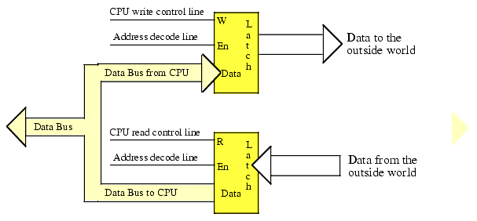
Input/Output Subsystem
The Input/Output subsystem allows the CPU to communicate with peripherals in such a way a liveware can interact with the computer system.
Peripherals are NOT directly connected to the CPU, the computer system has an interface known as I/O registers.
Figure 2.0, stargeeks.com, 2011/12/09, George Lencrow
Notes:
Input devices such as the keyboard, mouse, scanners etc. Output devices such as the monitor, printer, speakers etc.
The peripherals together with the Input/Output registers and CPU registers create a model where the liveware can request services from the computer system and receive information.

Slide 16
There are 3 ways I/O devices can transfer data from and to the CPU; Programmed I/O, Interrupt Initiated I/O & Direct Memory Access
Programmed I/O; A program is involved, that contains all I/O instructions as to how to transferring data should take place. The CPU must be inside the program loop during a task, this keeps the processor busy till the I/O system is ready for data transfer again.;
Interrupt Initiated I/O; The solution to the issue in Programmed I/O. This gives any peripheral the ability to send a signal to the CPU once the peripheral is ready for data transfer again. This will cause all ongoing operations to be temporarily halted, provides services on the request of the signal and returns back to it’s previous process once successfully completed.
Direct Memory Access (DMA); This technique involves the complete removal of the functionality of the CPU and instead lets the peripheral device to directly operate the memory buses, this technique is the fastest data transfer method.

Slide 17
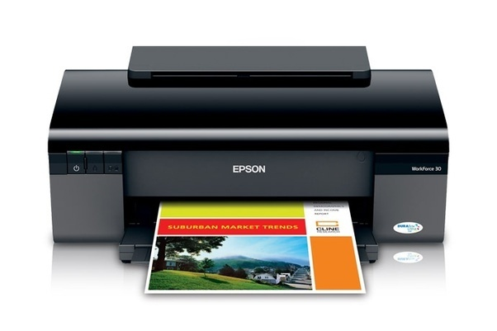
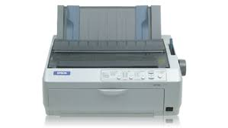
Printers
Printers are devices that perform a physical mechanism to turn soft copies into hard copies.
There are 2 categories of printers; Impact & Non-impact printers.
Impact printers apply a force on the paper against a surface while applying a substance on it(ink).
Non-impact printers do not perform any such operation hence are less noisy.
Non-impact printers are often preferred in the job industry as a whole. Mainly the laser printers due to their high-end efficiency and nearly no noise at all.
Figure 3.0 & 3.1, tutorialspoint.com, 2016/05/11, Peter Sanfield
Notes:
Printers are a vital device in a system. Among the 2 categories, there are particular types of printers massively used in the industry.

Slide 18
Dot-matrix Printers
Dot-matrix printers; An impact printer, that uses pins to print. These pins produce patterns of dots on the paper to form the individual characters. The higher the number of pins, the clearer the letters and faster the mechanism.
Each pin strikes individually on the paper with the ink on it, left to right or right to left. They are generally inexpensive and type 300~600 characters per second.
These printers are highly used in industries that need large numbers of quick printouts in a large number. Mainly because it has a decent speed to cost ratio.

Slide 19
Ink-Jet Printers
Ink-jet printers; A non-impact printer. Ink-jet printers have a similar concept in terms of the mechanism followed but instead of pins, you have charged droplets of ink. There are plates inside the printer that are charged as well, the charged ink is sprayed onto the plates.
The polarity(charge) of the plate changes rapidly in such a way a specific droplet of ink is attracted to due to electrostatic forces. In such a fashion, all ink is sprayed with respective to how they should be on the paper.
This particular printer is the best choice, if one were to print in more than one color. It is less noisy, fast and have good quality.

Slide 20
Laser Printers
Laser printers; A non-impact printer. This printer works a lot similar to a photocopy. Laser printers produce images on paper by directing a laser beam at a glass surface which bounces the beam onto a rotating drum.
The drum is usually covered in a special coating so that ink can attach to it. The laser beams are emitted in a pattern so that the paper’s charge changes in such a way the image on the soft-copy is perfectly mimicked. Then the ink is pressed against it.
Laser printers are ideal to print very quick color printouts at high quality, but maintenance and the cost of buying such a printer can be too high when buying in batches for some industries. If qualitative printing is preferred over quantitative printing, this is the right choice.

Slide 21
Microsoft Office
A bundled set of software made to satisfy all general office needs, from mailing to database creation.
In the industry however, Outlook, Excel and Word will be in the highest demand.
Microsoft Outlook maintains an on-point mailing service and allows you to manage, compose and send emails easily.
Microsoft Excel is a spreadsheet software, it is ideal to maintain records of accounts, produce pictorial representations of data and calculations.
Microsoft Word is a word-processing software, it performs all the tasks a text-editor would but better, with additional settings, options and utility functions to ease your workload ex: mail merge.
Notes:
Microsoft Office 2010 is the current standard in the industry, it has a much more refined look and has improvement on settings.
Microsoft Office trainning packages are very common nowadays, there are plenty of online courses you can look into while doing your job if you want to improve your skills or learn from scratch. These courses also include certification for a reasonable price. Websites like udemy.com offer some of the best courses out there. They’re self-paced, easy to learn and highly interactive.
It is essential to be good at these software, not only to cater towards an employer’s needs but also to hone your familiarity with a computer system.
I personally recommend following courses to cover special functions like mail-merge in Word as functions like these can help you have 1 over most of your fellow employees.

